Slide 1
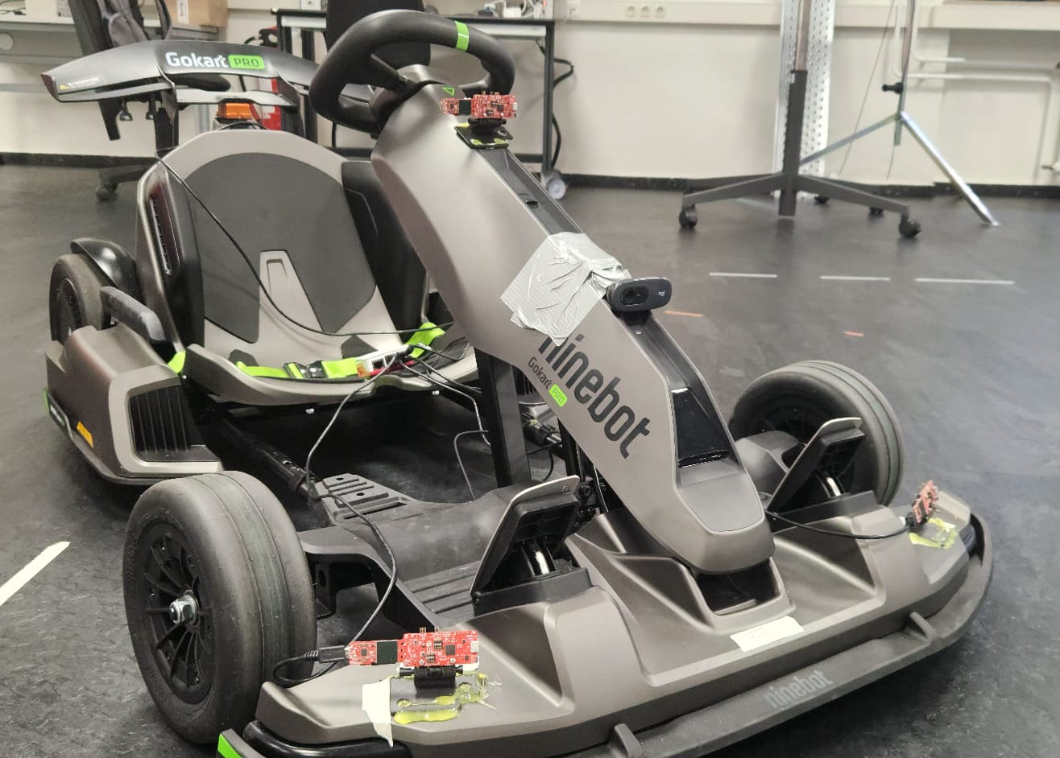
Radar odometry using mmWave technology for SLAM applications.
Radar-based Ego-Motion Estimation.
Author:
Luis Fernando Rodriguez Gutierrez
Supervisor:
Prof. Dr. Andreas Becker
Co-Supervisor:
Tobias Uhlich

Slide 2
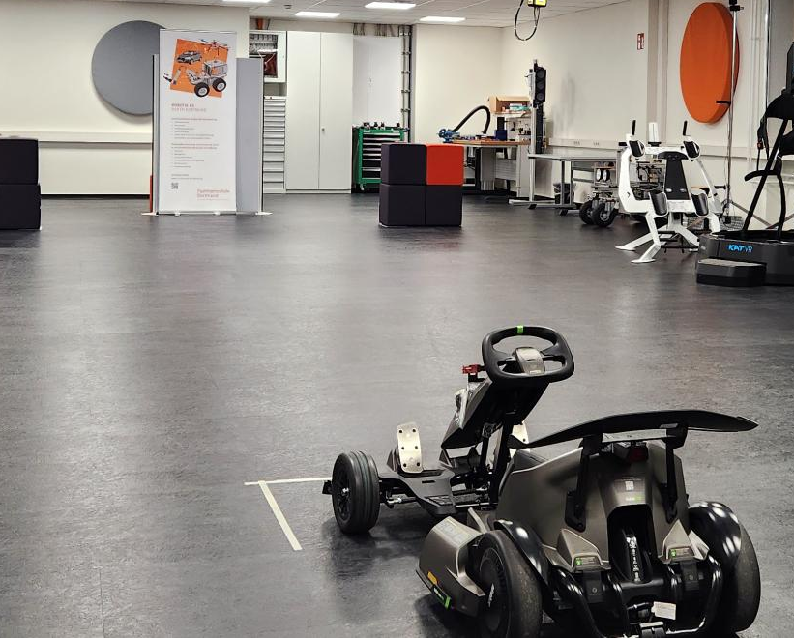
Project Overview
This project investigates radar-based ego-motion estimations using mmWave sensors and inertial measurements units (IMU) as foundation for autonomous navigation and SLAM.
The focus is on deriving vehicle motion (translation and rotation) from sparse point clouds, enhanced by Doppler and IMU data. This while keeping compute and sensor cost practical for embedded use.
Notes:
We aim for odometry first. SLAM is a later application

Slide 3
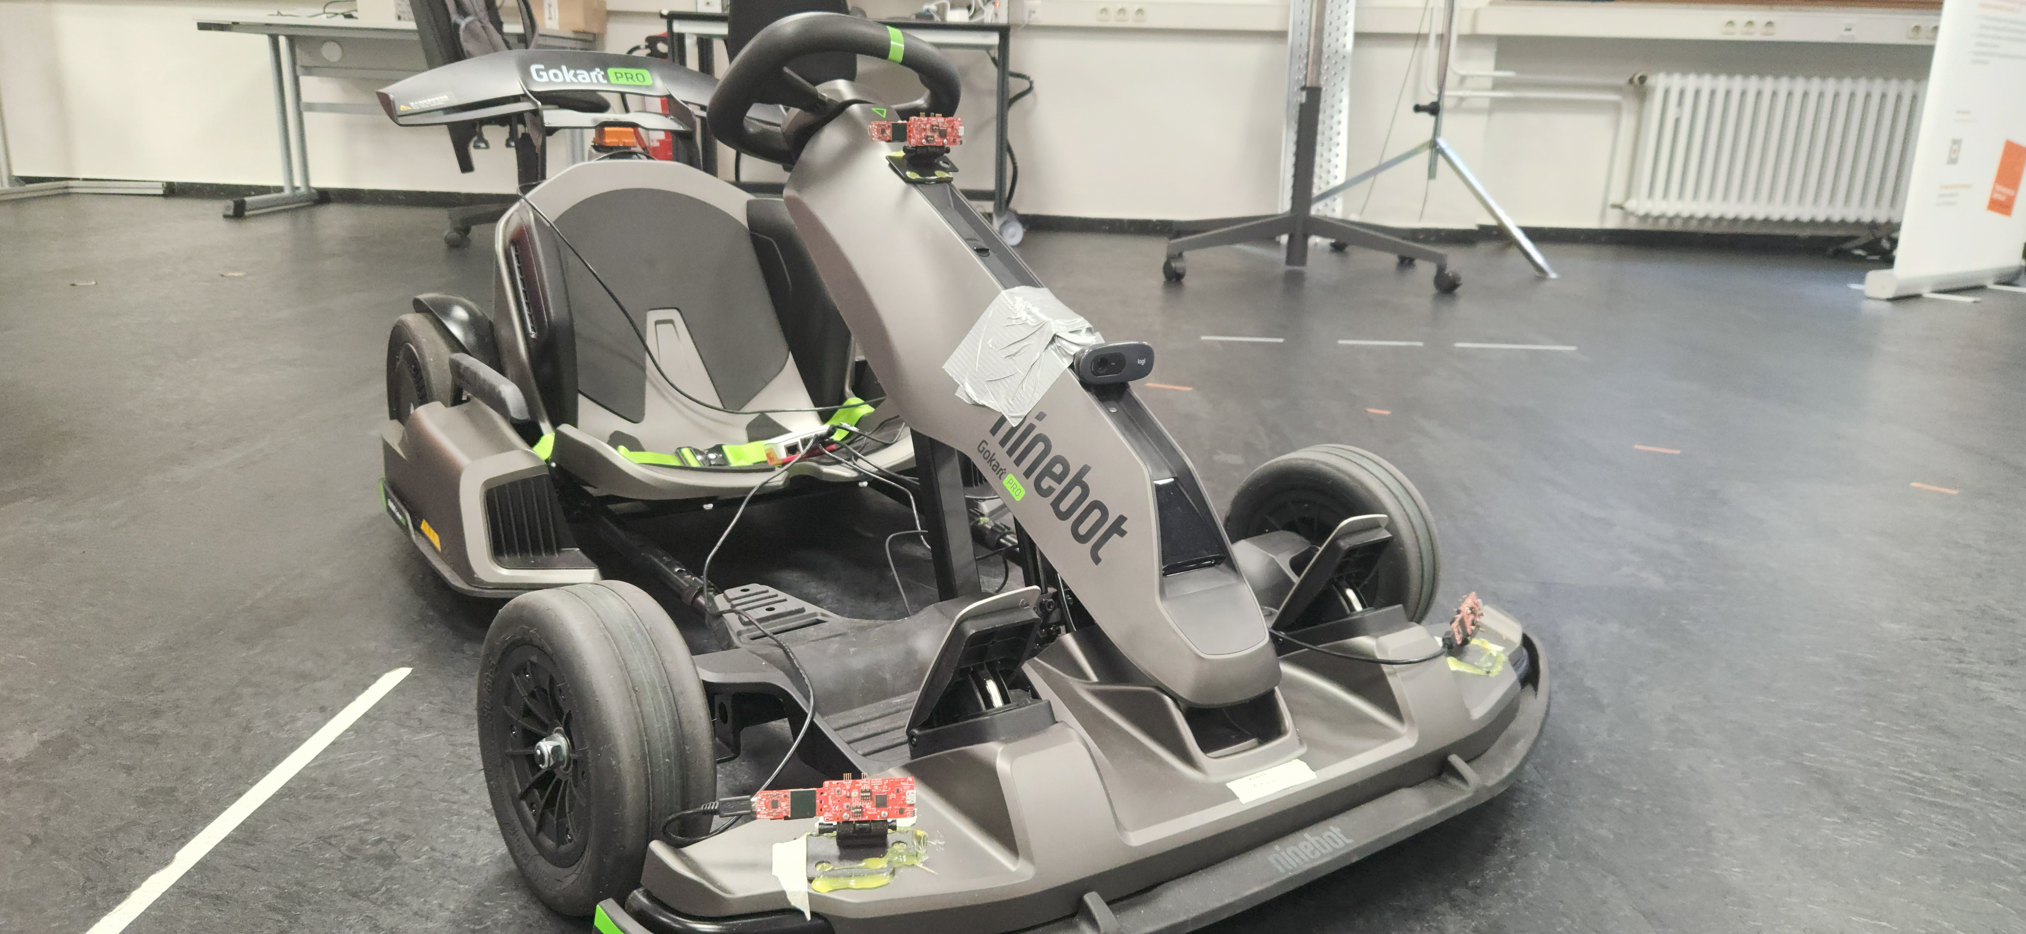
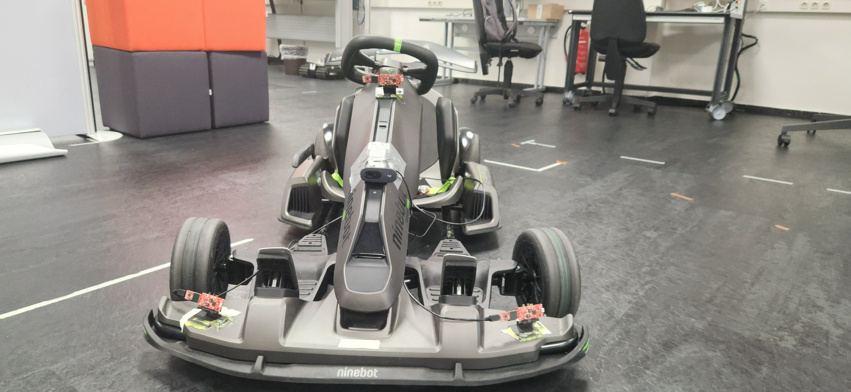
Project Overview Vehicle
Ninebot Gokart PRO
Max. Speed: 40 km/h.
Max Distance: 25 km.
Max Acceleration: 1,02 G.
Drift-Assistance System.

Slide 4
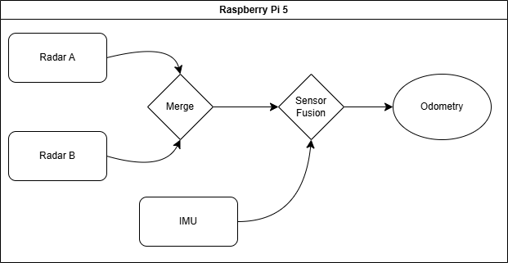
Project Overview System

Slide 5
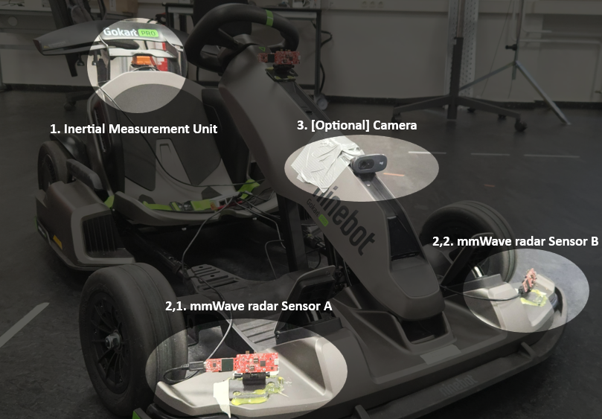
Hardware Setup
Sensors used for the project:
MTi-710, Inertial Measurement Unit.
IWR6843AOP, mmWave radar sensor.
Logitech C270 HD, Camera.

Slide 6
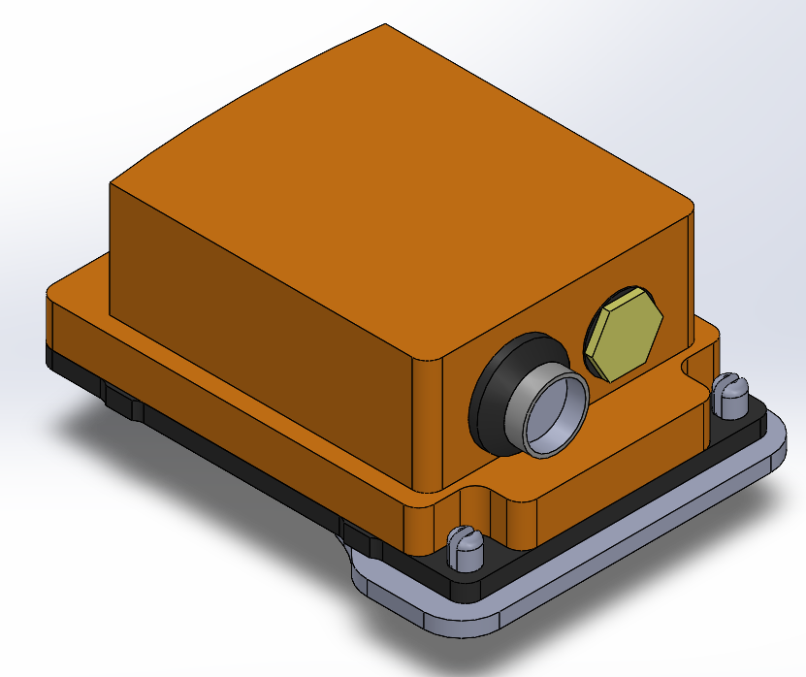
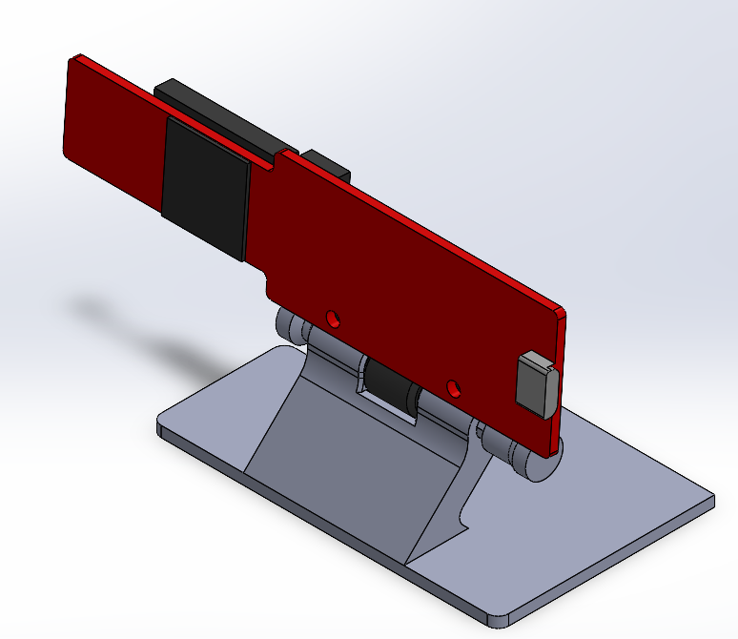
Hardware Setup 3D Modeling
To securely integrate the sensors into the vehicle, custom 3D-printed mounts were designed.
Each mount ensures an optimal alignment and positioning of the sensors to maintain consistent measurement geometry.
The models were developed in CAD to ensure the following points:
MTi-710, ensure close to no tilt to the sensor to avoid post processing.
IWR6843AOP, ensure stability when mounted and possibility to tilt the sensor to modify the field of view.

Slide 7
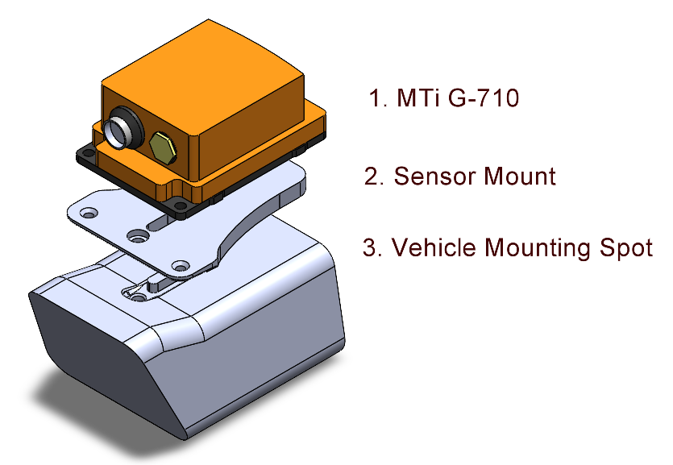
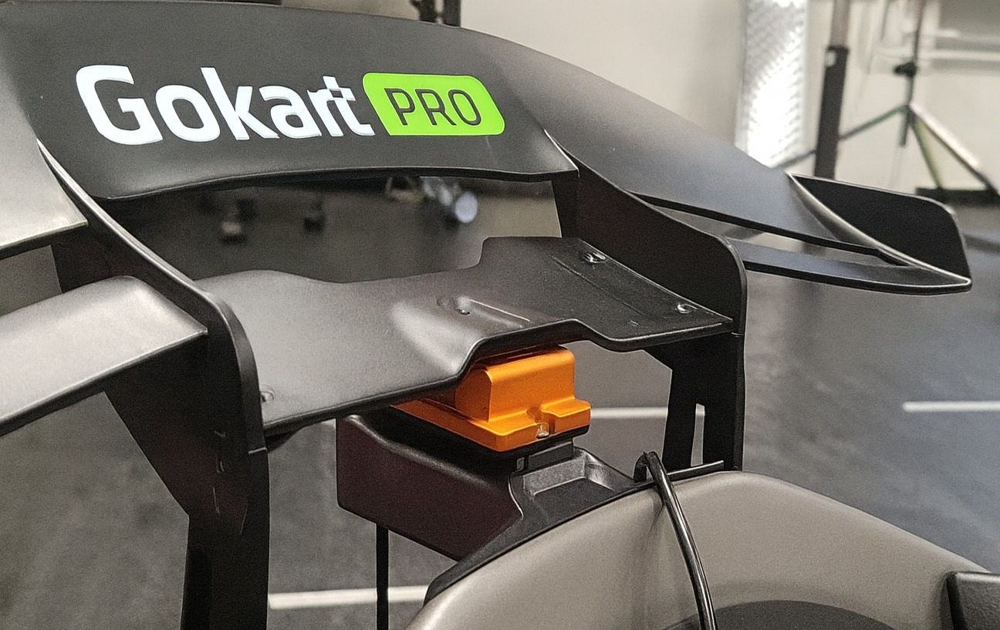
Hardware Setup MTi-710
The integration of the IMU was an interesting one. As the nature of the IMU is to measure the inertia and rotation, the mounting of this sensor is crucial. Depending on the position a post-processing needs to be done to ensure accurate measurements or place it in an “ideal” position. For this vehicle, the ideal place was found, however it needed a unique mount for the vehicle.

Slide 8
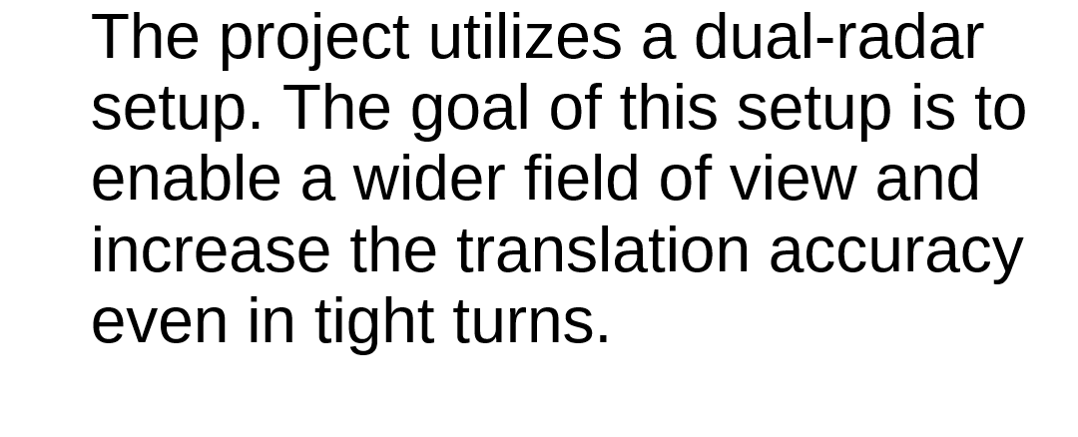
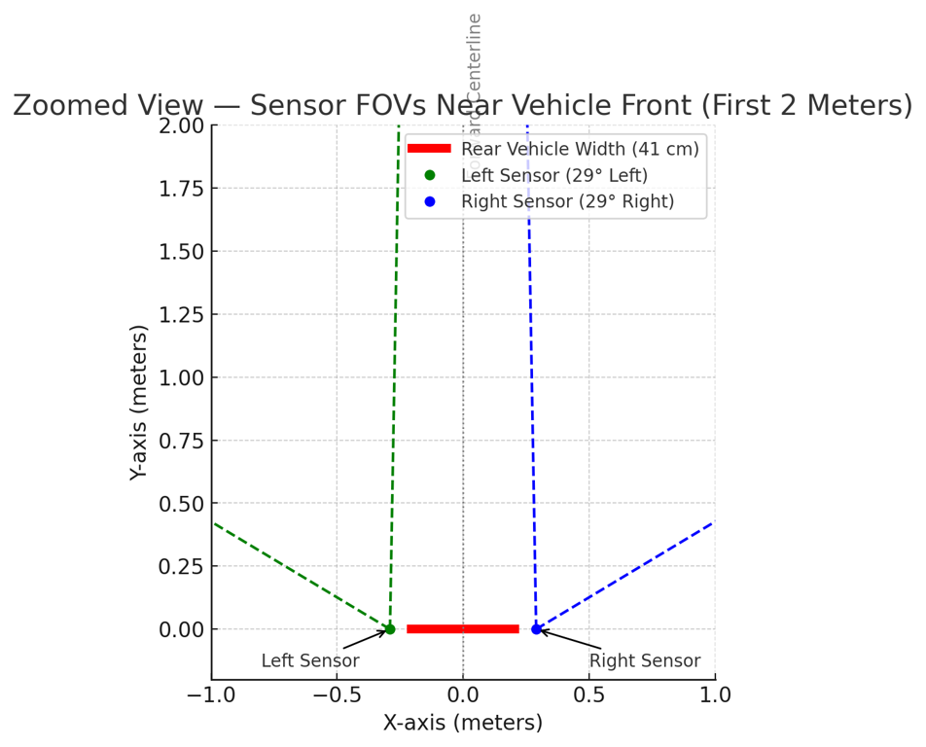
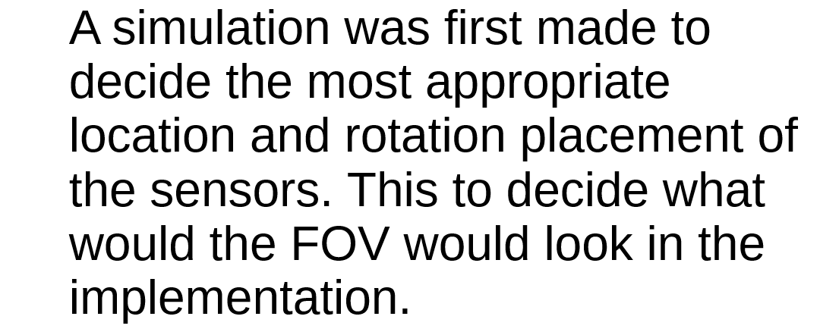
Hardware Setup IWR6843AOP

Slide 9
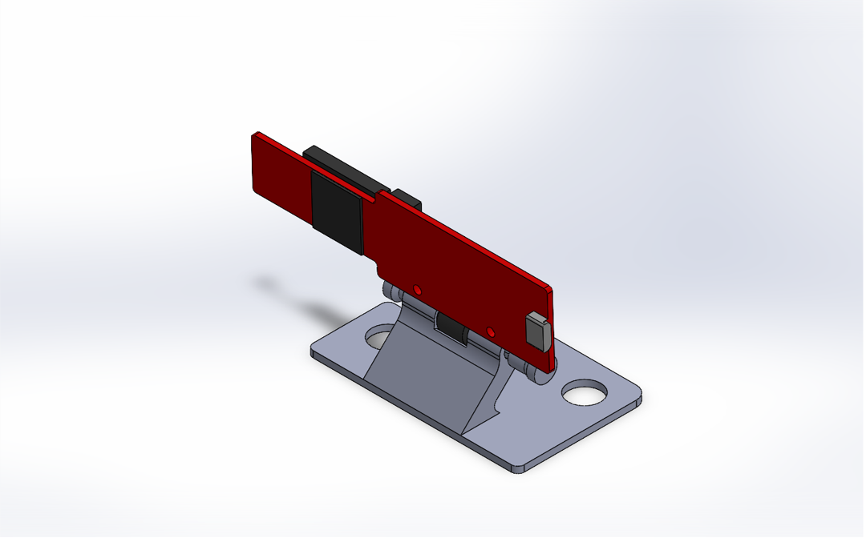
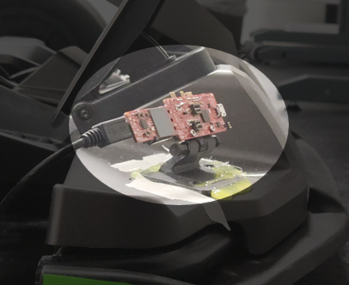
Hardware Setup IWR6843AOP
The radar modules were mounted with a 58 cm baseline along the vehicle’s X-axis to maximize the field of view.
Each sensor was tilted 15° upward to avoid as much clutter as possible from the ground and rotated outward 30° to expand the azimuth coverage.
Luis Fernando Rodriguez Gutierrez FH Dortmund, 2025, Master ESE
9

Slide 10
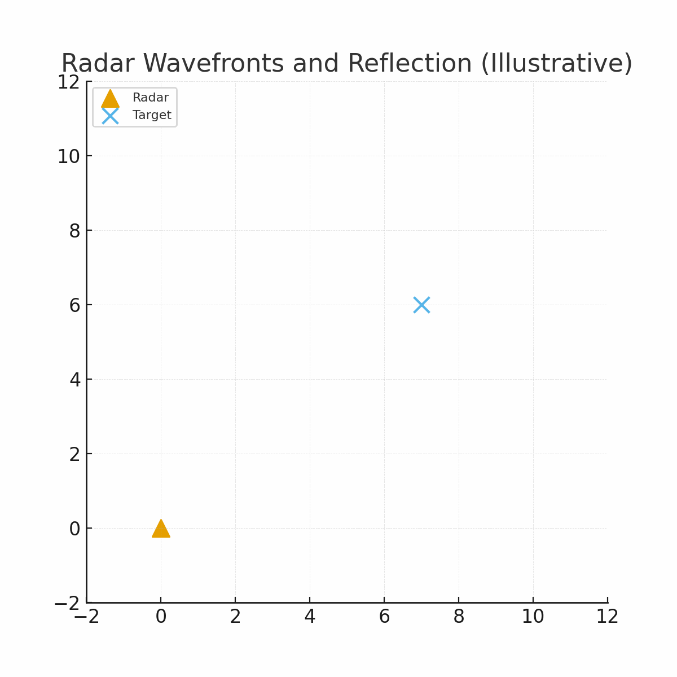
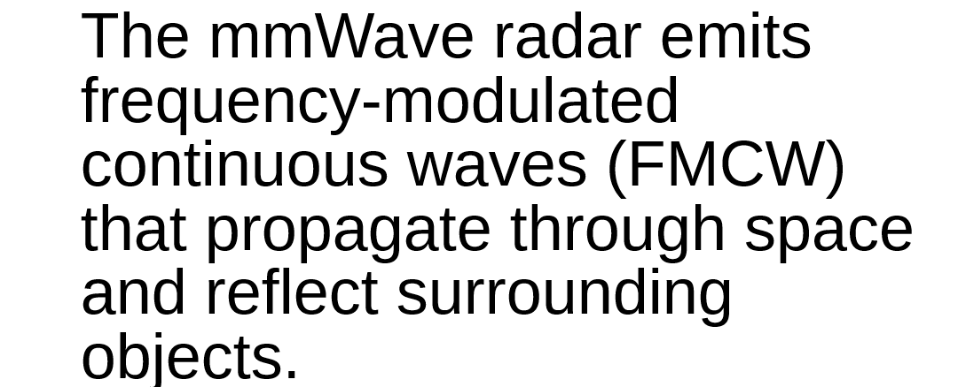
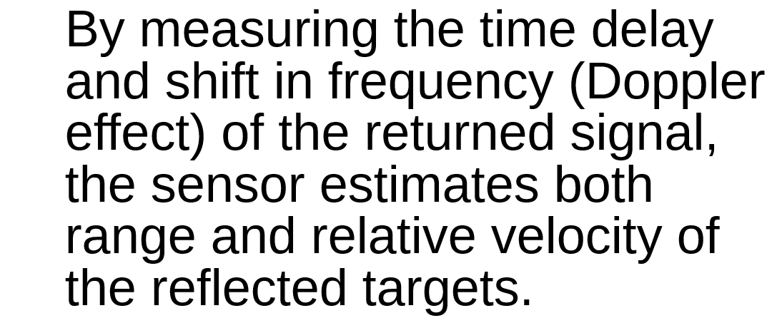
IWR6843AOP Understanding how IWR6843AOP works

Slide 11
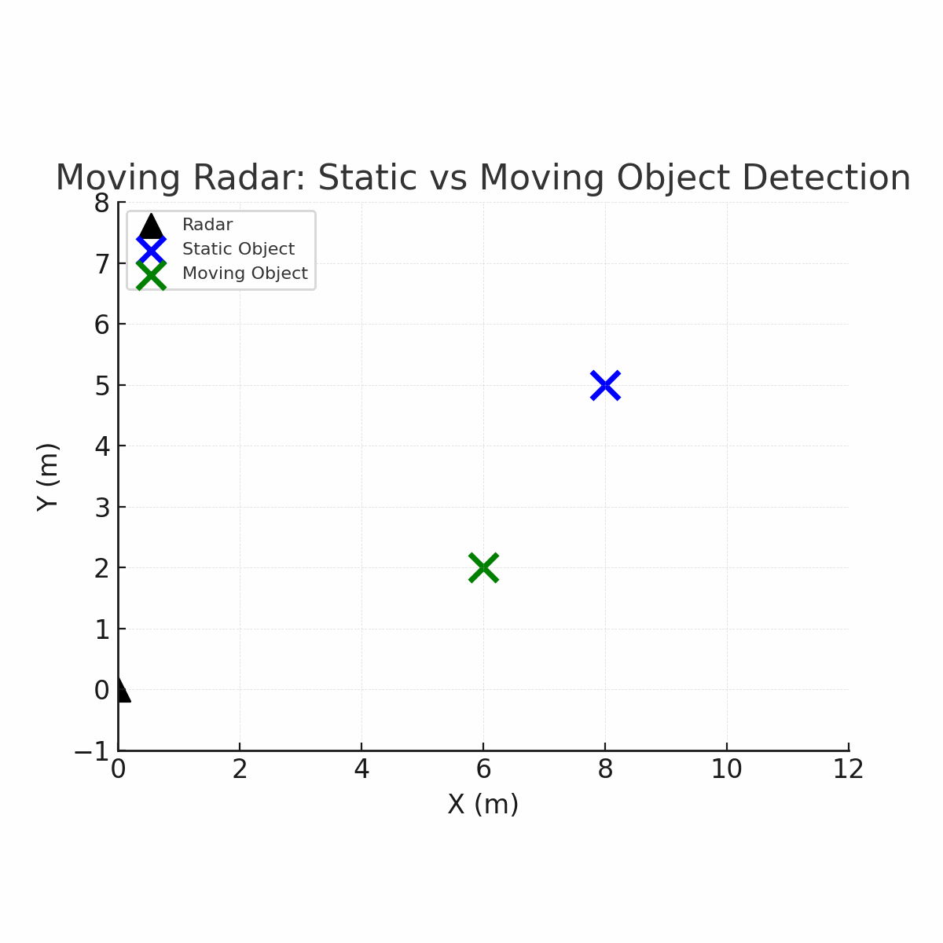
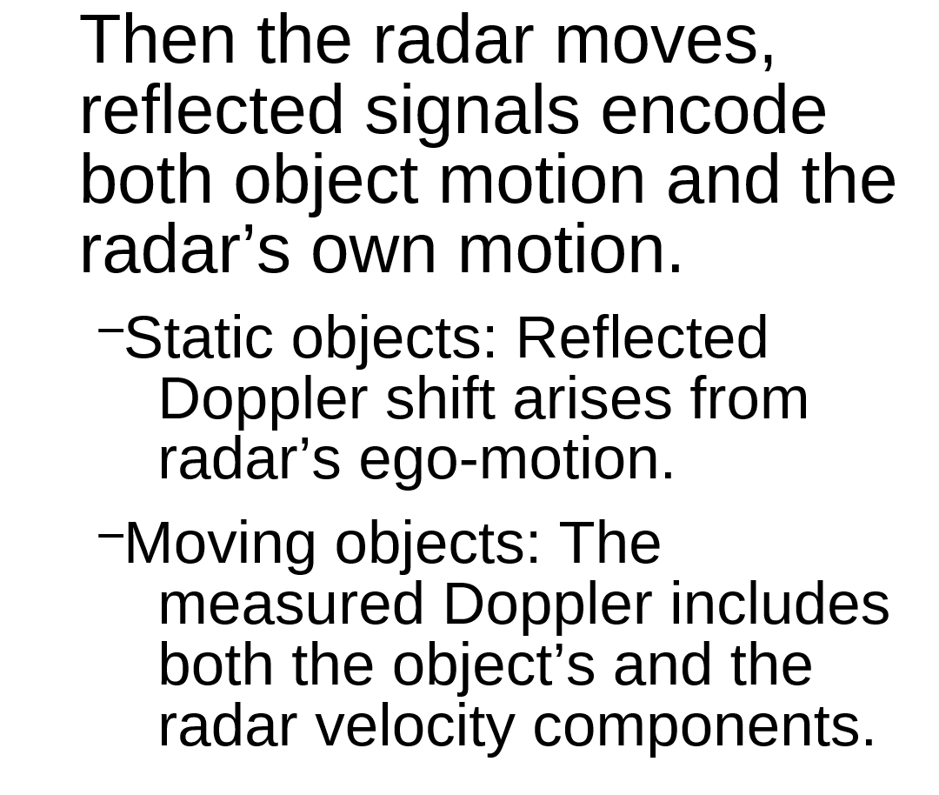
IWR6843AOP Static and Dynamic Objects

Slide 12
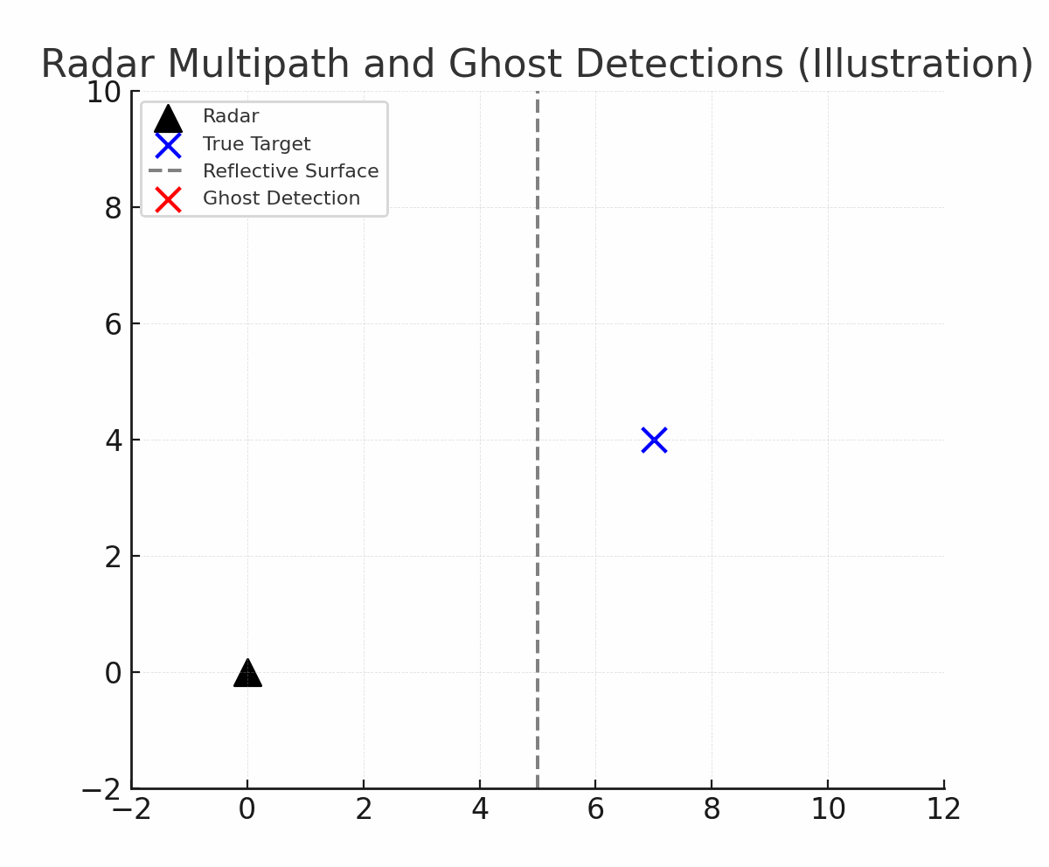
Problem Definition. Limitations of Radar for Odometry.
Sparse point clouds.
Radar detects only a few reflections per computed frame. Meaning weak geometric of non reflective material will not be easily detected.
Multipath and clutter.
Indirect reflections from metallic or smooth surfaces create ghost points or unreliable doppler detections.
Measurement noise.
Low SNR and range quantization cause unstable point locations and Doppler outliers.
Dynamic scenes.
Moving objects introduce inconsistent detentions between frames.

Slide 13
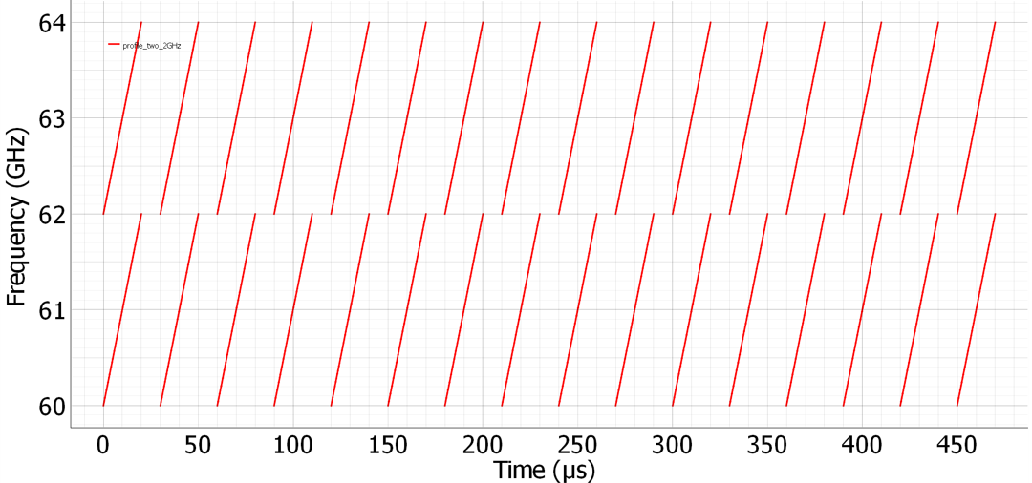
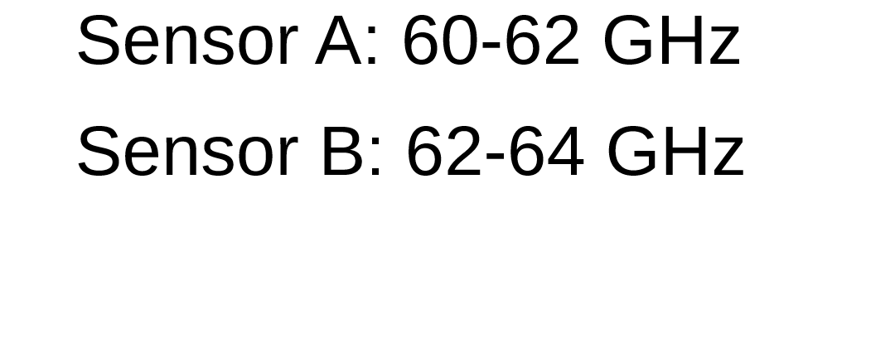
Problem Approach. Limitation of a Dual-Radar setup.
To avoid the multipath of “ghost detections” when using 2 radars a simple solution is often used, such as using different frequencies in each sensors.

Slide 14
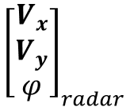
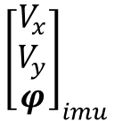
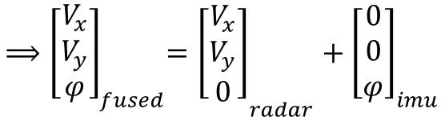
Problem Approach. Translation and Rotation.
Why mmWave + IMU?
Environmental robustness: Operates reliably under adverse conditions, such as rain.
Doppler advantage: Directly measures radial velocity, reducing ambiguity in motion estimation.
Inertial support: IMU provides pose estimates complementing radar’s data.
Combined benefit:
Radar provides accurate translation.
IMU provides consistent rotation.
and

Slide 15
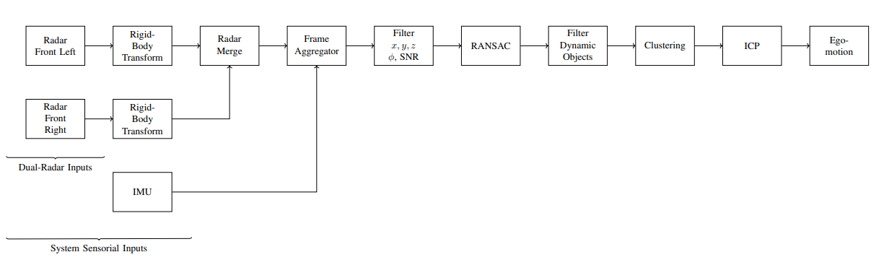
Method Overview Pipeline

Slide 16
Method Overview Pipeline Code Implementation

Slide 17
Method Overview Preprocessing and Sensor Fusion
Rigid-Body Transform: Converts each radar’s local coordinates into the vehicle frame.
Radar Merge: Combines both sensors into one unified point cloud.
IMU Integration: Provides angular rate φ and orientation for frame-to-frame alignment.
Frame Aggregation: Build submaps (Q).
Around 10 frames improve spatial sparsity.

Slide 18
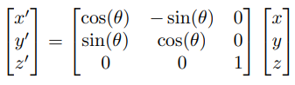
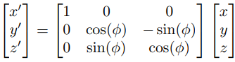
Method Overview Preprocessing and Sensor Fusion
Yaw Transform:
Pitch Transform:

Slide 19
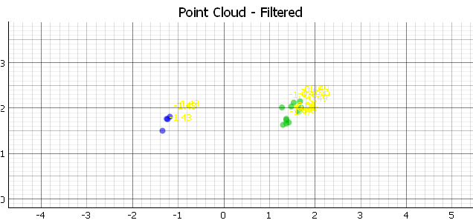
Method Overview Preprocessing and Sensor Fusion

Slide 20
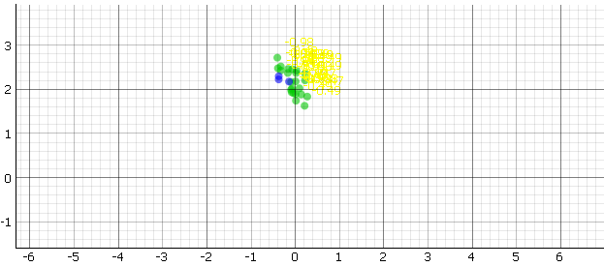
Method Overview Preprocessing and Sensor Fusion

Slide 21
Method Overview Filtering Point Selection
Removal of invalid spatial values and low-SNR points.
Cartesian Coordinate
SNR Filter

Slide 22
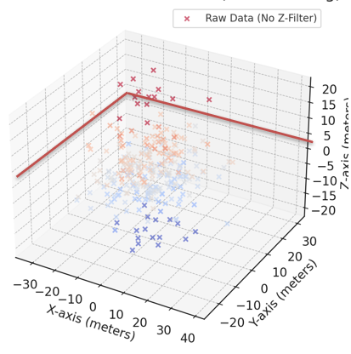
Method Overview Filtering Point Selection

Slide 23
Method Overview Robust Point Selection
RANSAC: Reject outliers by fitting a consistent motion model to radar points.
Dynamic Object Filter: Uses Doppler analysis from the RANSAC model to detect outliers that match moving objects.

Slide 24
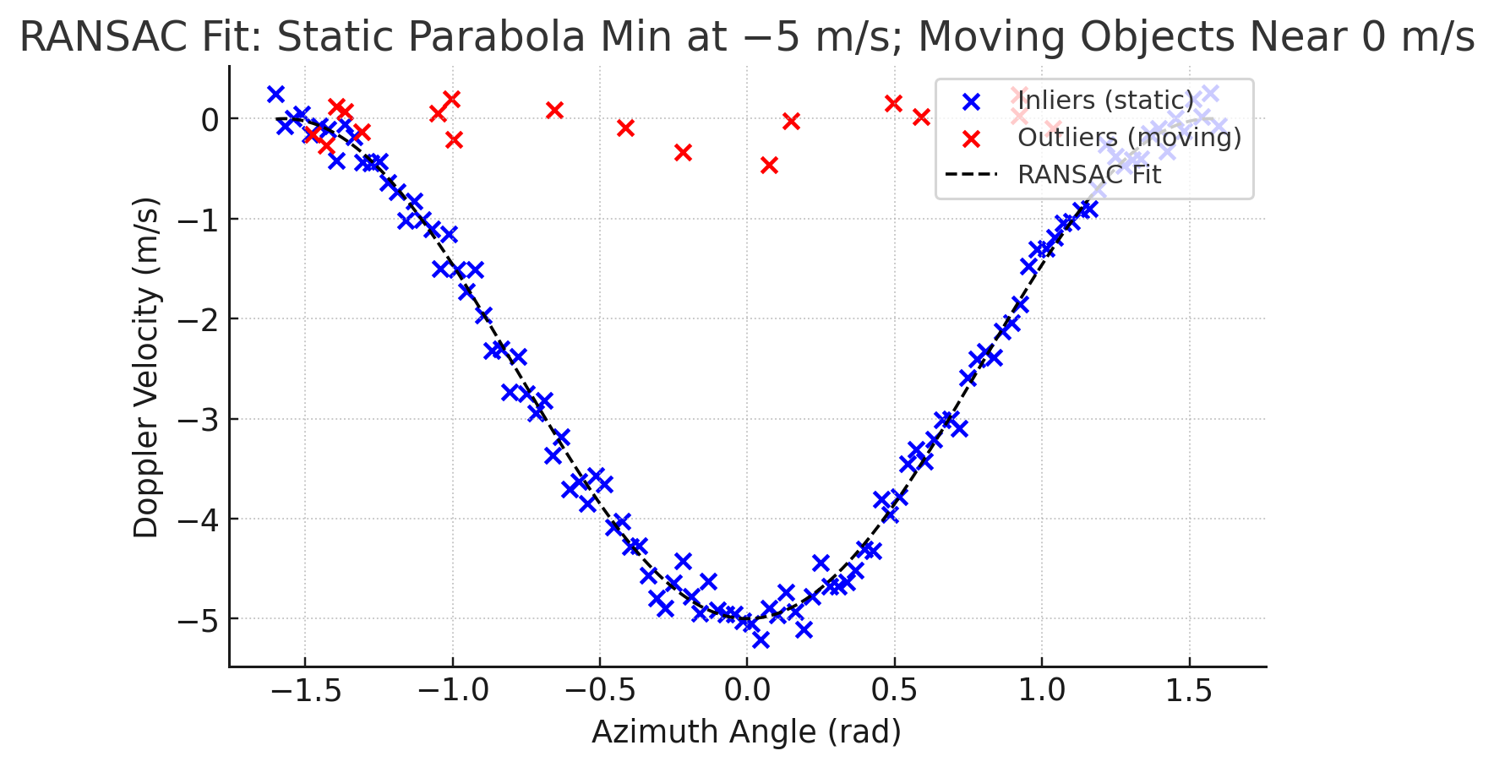
Method Overview Robust Point Selection

Slide 25
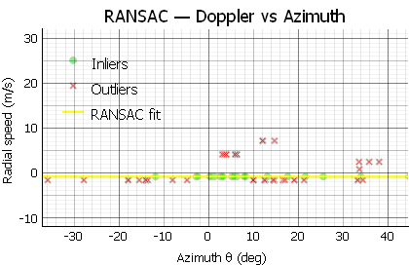
Method Overview Robust Point Selection

Slide 26
Method Overview Clustering
Clustering: DBSCAN, Grounds neighboring points to form environmental features.
Great for finding geometrical patterns.

Slide 27
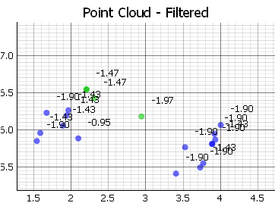
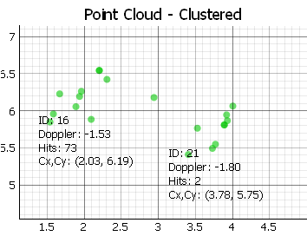
Method Overview Clustering

Slide 28
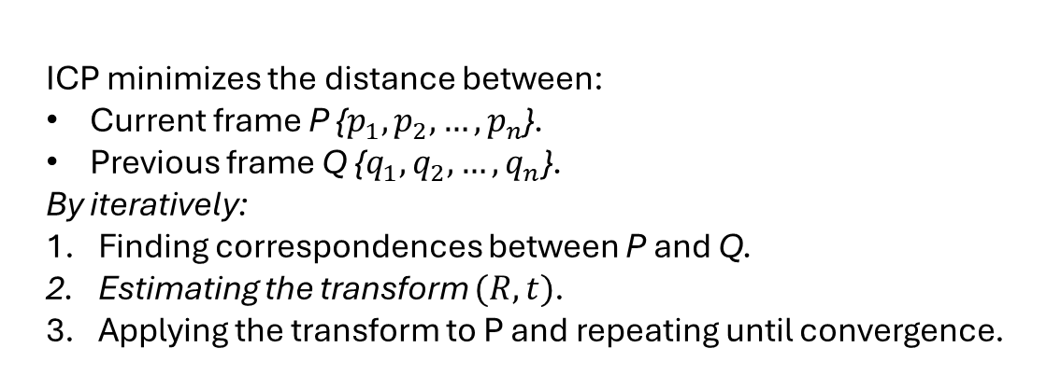
Method Overview Iterative Closest Point
ICP minimizes the distance between:
Current frame P {$p_{1},p_{2},…,p_{n}$}.
Previous frame Q {$q_{1},q_{2},…,q_{n}$}.
By iteratively:
Finding correspondences between P and Q.
Estimating the transform $(R, t)$.
Applying the transform to P and repeating until convergence.

Slide 29
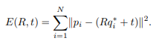
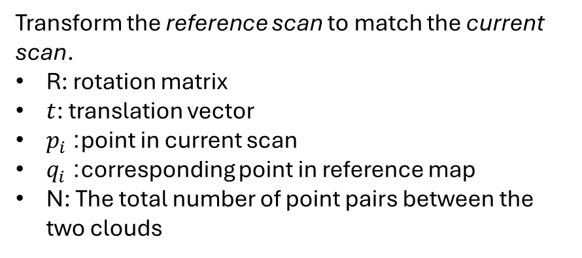
Method Overview Iterative Closest Point
Transform the reference scan to match the current scan.
R: rotation matrix
$t$: translation vector
$p_{i}$: point in current scan
$q_{i}$: corresponding point in reference map
N: The total number of point pairs between the two clouds

Slide 30
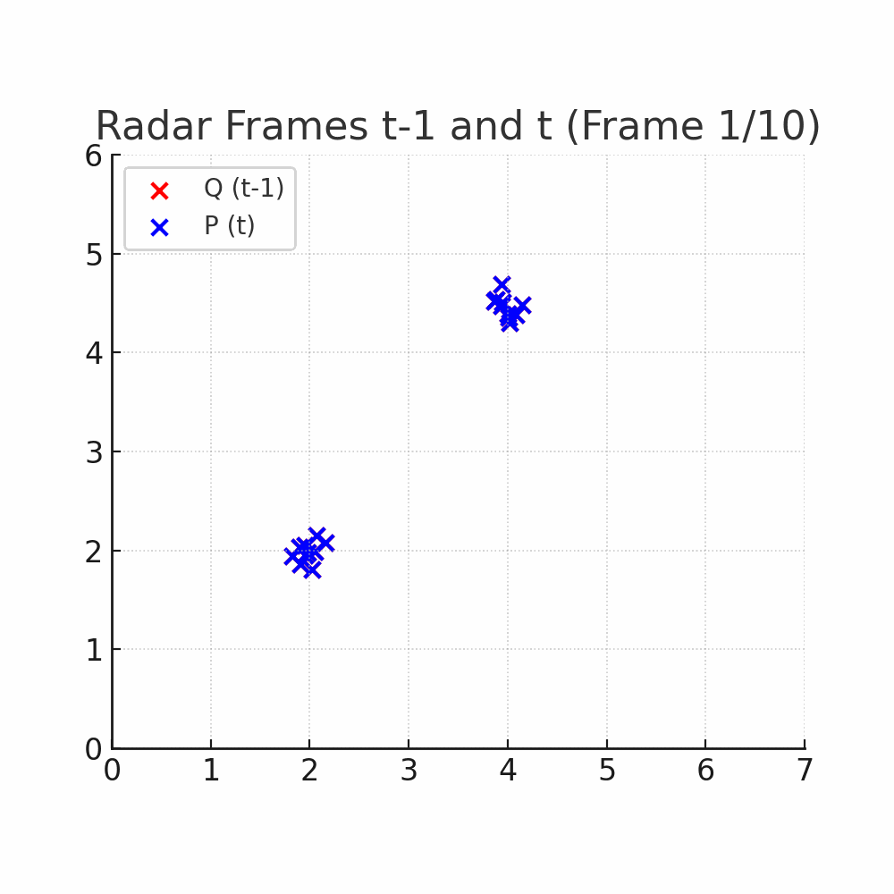
Method Overview Iterative Closest Point

Slide 31
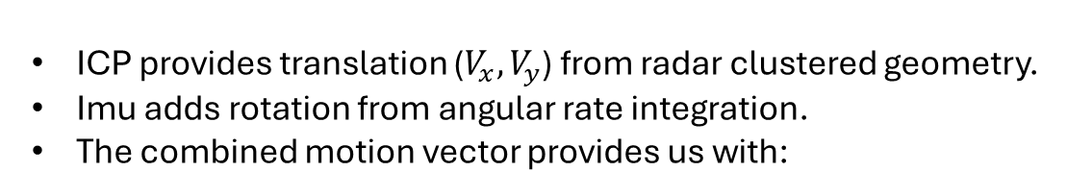
Method Overview Ego-Motion
ICP provides translation ($V_{x}, V_{y}$) from radar clustered geometry.
Imu adds rotation from angular rate integration.
The combined motion vector provides us with:
The accumulation and sequential composition of these transforms gives us the odometry trajectory.

Slide 32
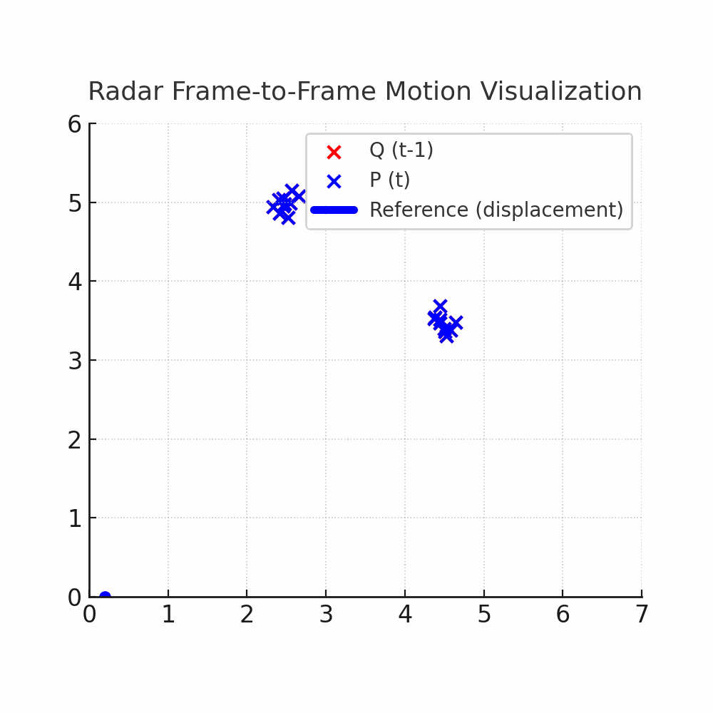
Method Overview Ego-Motion

Slide 33
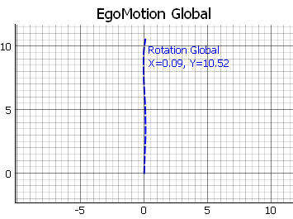
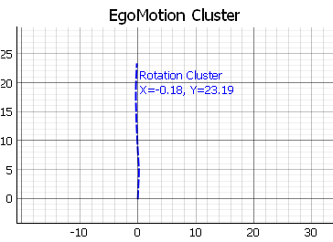
Method Overview Ego-Motion Laboratory

Slide 34
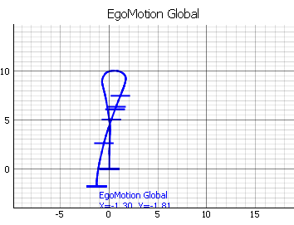
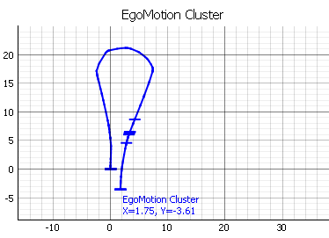
Method Overview Ego-Motion Laboratory

Slide 35
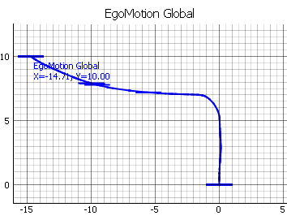
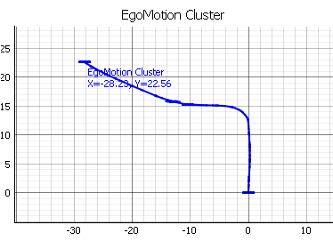
Method Overview Ego-Motion Hallway

Slide 36
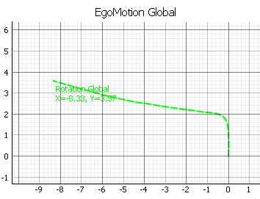
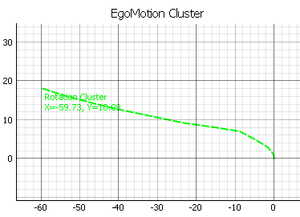
Method Overview Ego-Motion Parking Lot

Slide 37
Results and Discussion Comparison Between Full Point Cloud and Cluster-Based Odometry
Environment | Characteristics | Best Method | Explanation
Indoor Laboratory | Complex multipath. | Full Point Cloud | The abundance of reflections provides sufficient correspondences for robust matching, even without clear landmarks.
Outdoors Parking Lot | Sparse reflections. Clear large-scale landmarks. | Clustered-Focused | Stable clusters around static landmarks (e.g., walls, cars, curbs) allow more reliable ego-motion estimation despite lower point density.

Slide 38
Results and Discussion Comparison Between Full Point Cloud and Cluster-Based Odometry
Full point cloud ICP is robust in dense and reflective indoor environments but suffers from noise sensitivity outdoors.
Cluster-based ICP outperforms in structured, sparse environments where distinct landmarks dominate.

Slide 39
Conclusion
The proposed mmWave + IMU fusion framework successfully demonstrated ego-motion estimation using dual radar sensors.
Results show that the environment type critically affects ICP performance:
In dense indoor environments, the global point cloud approach provides better stability due to the abundance of reflections.
In sparser outdoor scenes, the cluster-focused approach significantly improves accuracy by anchoring motion to static landmarks.
This confirms that mmWave radars can serve as a viable low-cost alternative for odometry in GPS-denied scenarios when complemented by inertial measurements.

Slide 40
Future Work
Implement rotation using radar-only.
Extend to 3D radar odometry and fuse with vision-based mapping for richer scene understanding.
Integrate loop-closure detection for long-term drift correction.
Extend evaluate performance under adverse weather to confirm radar’s environmental resilience.

Slide 41
Acknowledgments
Special thanks to:
Supervising Professor: Prof. Dr. Andreas Becker.
For his guidance, feedback, and continuous technical supervision throughout the project.
Co-Supervisor / Assistant: Tobias Uhlich.
For his support in radar data acquisition, experimental setup, and analysis.
External Contributor: Morten Nisov. [Norwegian University of Science and Technology (NTNU)]
For valuable discussions and assistance in solving technical challenges.
Collaborating Students: Igor Risteski [FH Dortmund].
For his help during radar calibration procedures and system testing sessions.

